Slide 1
Trading Journal App
Group Members :
36 Anthony Brighton Stalin Nadar
38 Vaishnavi Nagave
35 Nikita Maurya
24 Vijay Gupta
Guide : Prof. Tayyabali Sayyad
1

Slide 2
Introduction
What is Trading Journal?
Use to keep the track of your trades and trading progress.
Helps to become efficient traders by learning where you do well and where you make mistakes.
Target Audience: Stock Investors
2

Slide 3
Problem statement
To design a trading journal which will allow a trader to :
Record the intraday trades.
Analyze win rate.
Record the strategies.
Identify weak points.
3

Slide 4
Scope
Organize trading data in well structured form.
Track progress.
Graphical representation of trading data.
Profit /loss earned.
Win/loss ratio of trades.
4

Slide 5
Features
Desktop App
Supports multiple trading journal
Performance reports
Analysis of trading data
Strategy option
5

Slide 6
UI Prototype
6

Slide 7

7

Slide 8
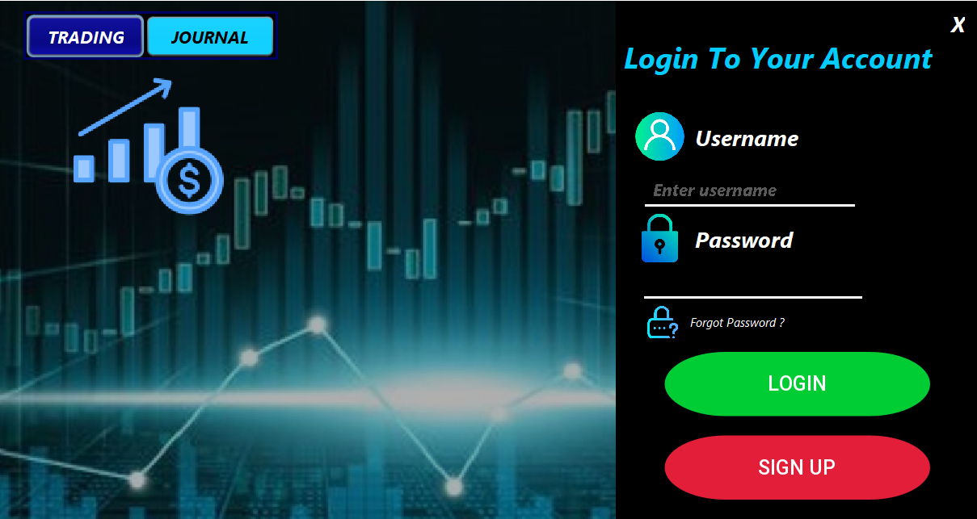
8
7

Slide 9
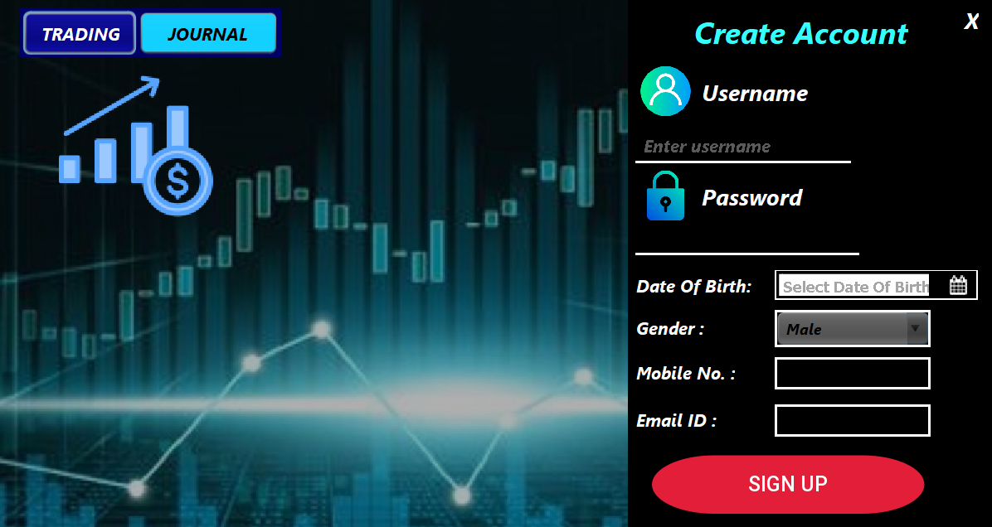
8
9

Slide 10
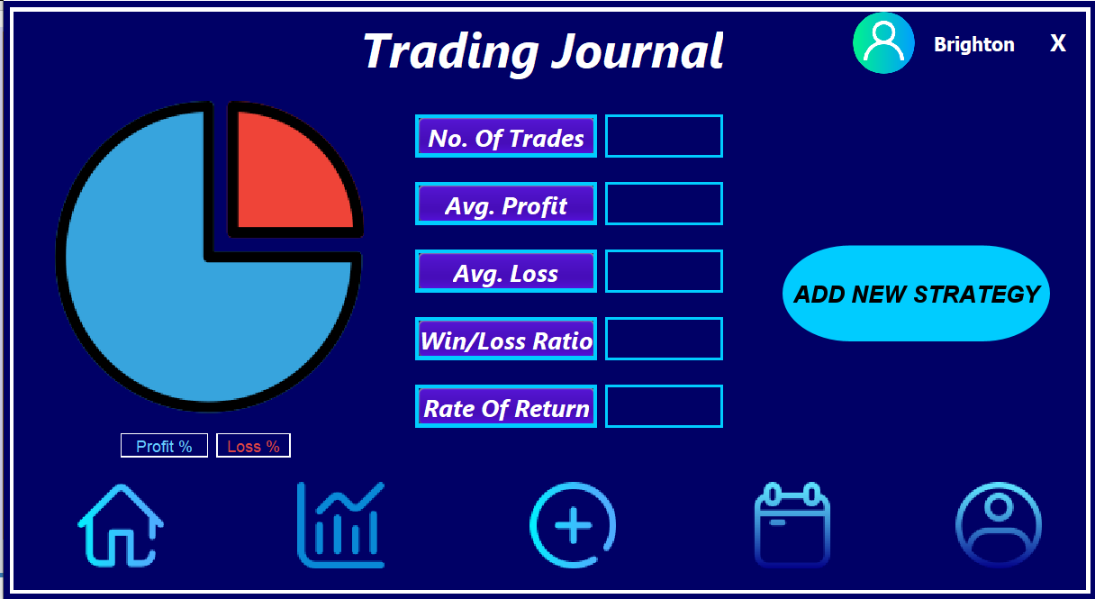
9
10

Slide 11
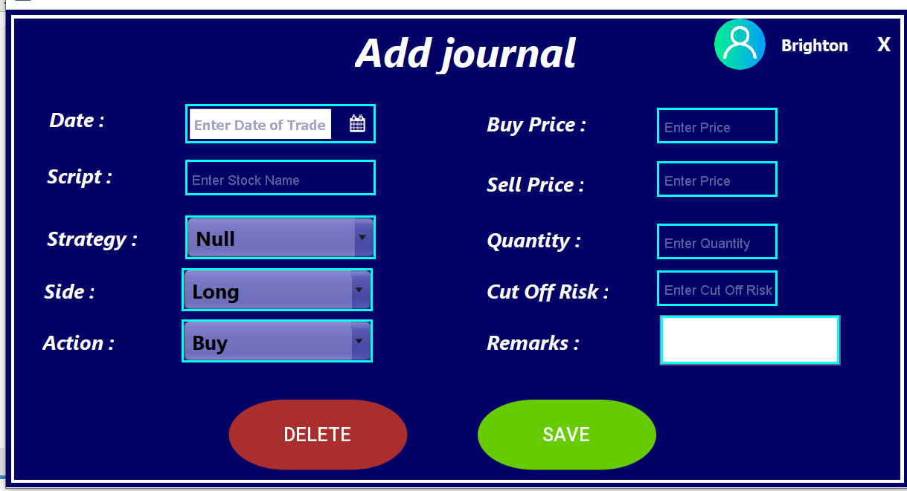
10
11

Slide 12
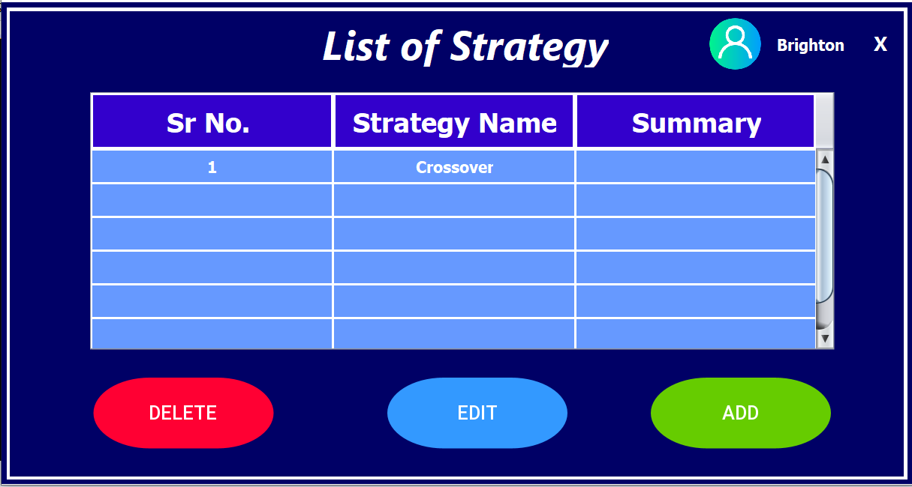
11
12

Slide 13
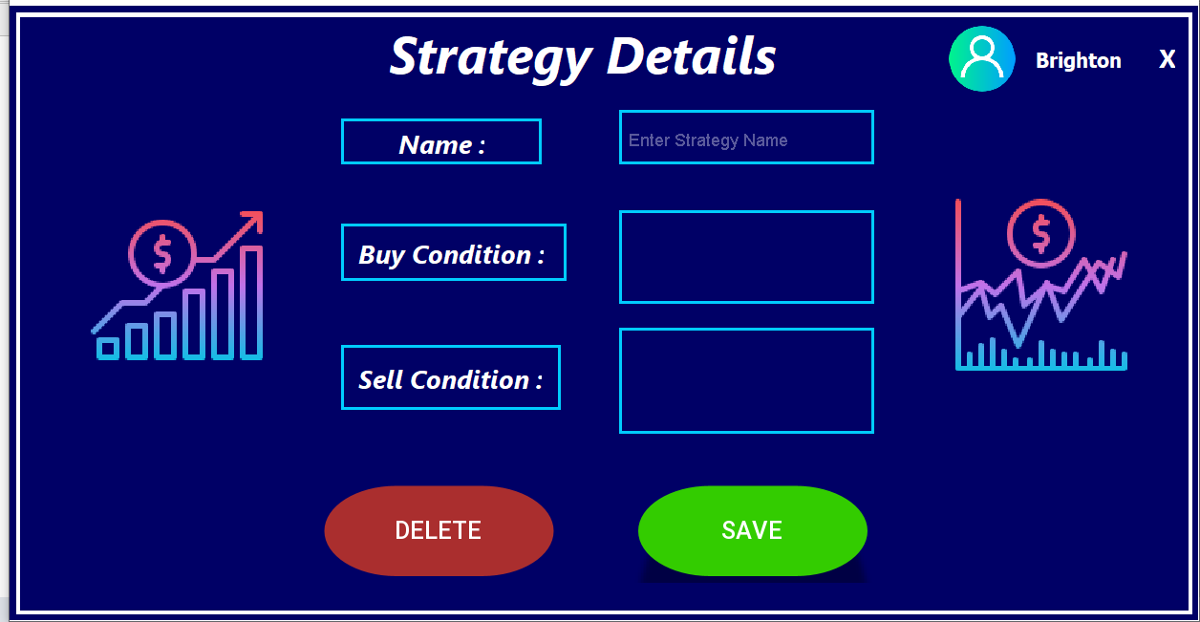
12
13

Slide 14
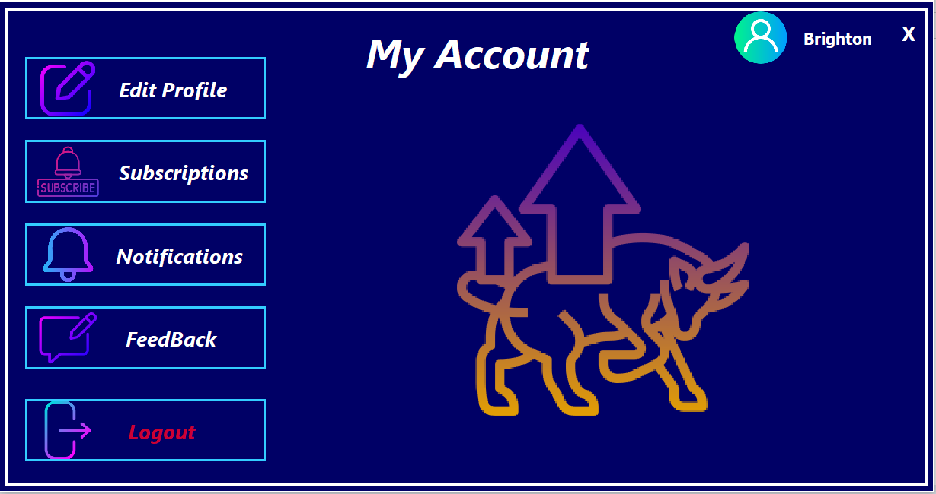
14

Slide 15
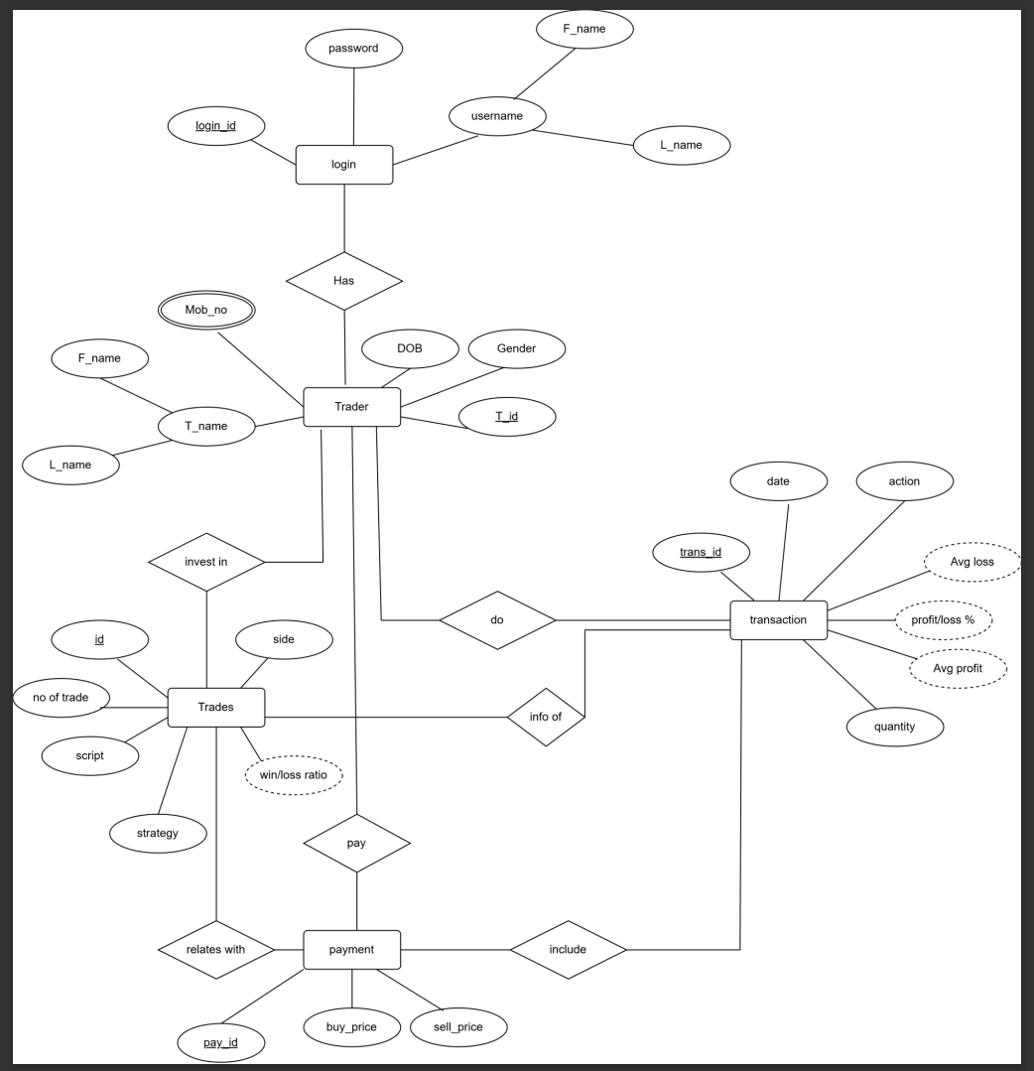
Database Designs
15

Slide 16
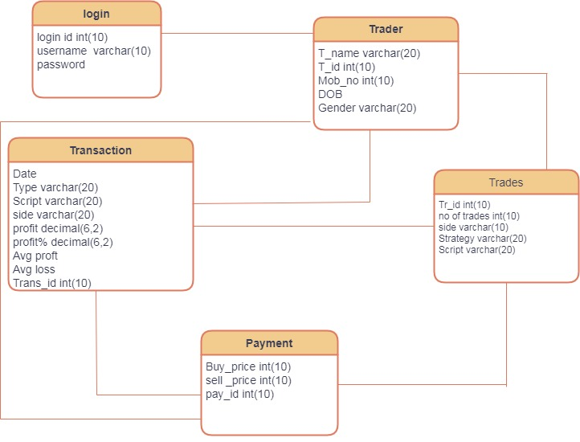
16

Slide 17
Technology Used
1. Java FX
2. MySQL Server
3. Java NetBeans
17

Slide 18
Contributions
1. Anthony Brighton - UI Design
2. Nikita Maurya - UI Design
3. Vaishnavi Nagave - Database Design
4. Vijay Gupta - Database Design
18

Slide 19
References
1. https://app.diagrams.net/
2. https://play.google.com/store/apps/details?id=www.stocksmadeeasy.in
3. https://netbeans.apache.org/download/index.html
19

Slide 20
GitHub Repository link
https://github.com/nikitam614/java_mini_project.git
20

Slide 21
Thank You!!!
21

